Slide 1
How to write an Algorithm and its Basic

Slide 2
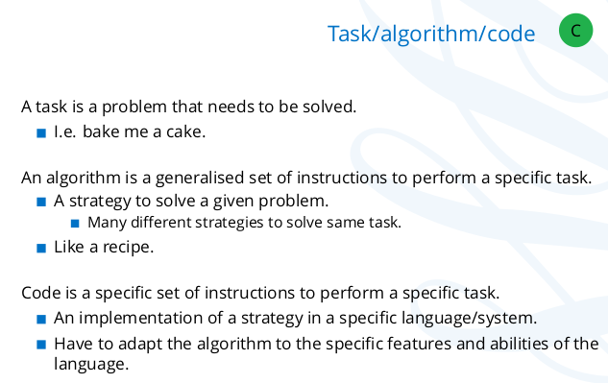

Slide 3
How to write an Algorithm
There are no well-defined standards for writing algorithms.
It is problem and resource dependent.
All programming languages share basic code constructs like loops, flow-control, etc. These common constructs can be used to write an algorithm.
Algorithm writing is a process and is executed after the problem domain is well-defined.

Slide 4
Example: problem – algorithm to add two numbers and display the result.
start
Declare three integers a, b and c
Define values of a and b
Add values of a and b
Store output of step 4 to c
Print c
stop

Slide 5
Example: other way
Start
Get values of a and b
C --> a + b
Display c
stop

Slide 6
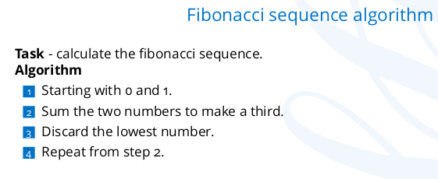

Slide 7
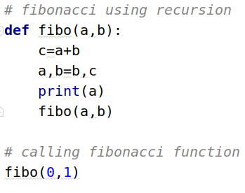
Using Recursion:

Slide 8
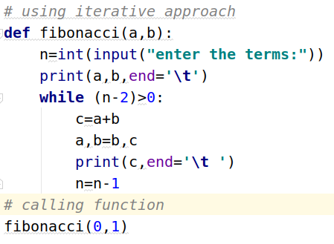
Using Iterative:

Slide 9
one problem can be solve in different ways.
Solution A
Solution B
Problems
Solution C
Solution D

Slide 10
So which one algorithm should we choose?
We Choose ==>> Most Efficient / best suited for our requirement.
- Efficiency depends on:
Running time
Memory

Slide 11
Algorithm Complexity: Two main factors, which decide the efficiency of X.
Time Factor – Time is measured by counting the number of key operation such as comparisons in the sorting algorithm.
Space Factor – Space is measured by counting the maximum memory space required by the algorithm.

Slide 12
Measuring running time of an algorithm:
Experimental Method
Analytical Method

Slide 13
Experimental Method:
Implement the algorithm in a language and execute it.
Dependent on hardware and software
Runs it on different inputs.
Limited number of inputs
Record the exact Running time.
Not feasible for algorithm that take long time to execute.

Slide 14
Analytical Method:
It is also known as Asymptotic analysis.
In this method, it is not necessary to calculate the exact running time.so no need to run the program.
Points:
Analyze running time based on input size.
Independent of the software and hardware
Consider all possible inputs.

Slide 15
Asymptotic analysis:
depends
Size of input(n)
Running time
Small input size ------------> less Running time
Big input size ----------------> More Running time
Input size increases ---------> Running time also increases
Input size is doubled ---------> Running time might double
Input increases n size----------> Running time increases n times.
All this depends upon the algorithm.
Above behavior is study in Asymptotic analysis.

Slide 16
Asymptotic analysis:
Asymptotic analysis analyze how the running time of an algorithm increases with increase in input size.
Remember:
If the running time of an algorithm increases very rapidly with the input size then that algorithm will not be considered a efficient algorithm.
In asymptotic analysis we do not care about the exact running time.
It focus on what happens when the input size is large.

Slide 17
Determining efficiency of an algorithm??
How the algorithm behaves when the input size is increased.

Slide 18
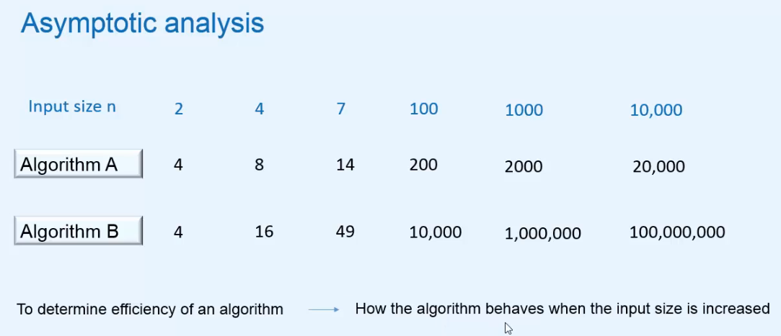

Slide 19
Analysis of Time Complexity

Slide 20
Analysis of Time complexity
Running time depends many factor but we compute it based on input size.
So, we need to calculate rate of growth of time w.r.t input.
Assumption:
All arithmetical and logical operation taking = 1 unit of time
All return statement is also taking = 1 unit of time

Slide 21
Time Complexity:
problem-1 To find Square of a number:
solution 1:
def solution1(n):
c=0
total=0
while c < n :
total=total + n
return total

Slide 22
Time complexity
solution 2:
def solution2(n):
return n*n
Now we have to solution of a problem so we have to find which one is efficient. for that we have to find the time complexity.

Slide 23
Calculating time complexity
Time complexity: solution 1
def solution1(n): Time
c=0 --> 1
total=0 -> 1
while c < n : --> n
total=total + n -> n
return total --> 1
Total time= 1+1+n+n+1=2n+3
Now neglect the constant term: n so the time complexity is O(n)

Slide 24
Calculating Time Complexity
Time Complexity solution 2
def solution2(n): Time
return n*n --> 1
So the time complexity is 1.Hence it O(1)
Note – if we get any constant then its time complexity will be O(1)

Slide 25
Big O notation :
Big O notation is a mathematical notation that describes the limiting behavior of a function when the argument (input) tends towards a particular value or infinity.
Big O notation is used to classify algorithms according to how their running time or space requirements grow as the input size grows.
Big O notation characterizes functions according to their growth rates: different functions with the same growth rate may be represented using the same O notation.
The letter O is used because the growth rate of a function is also referred to as the order of the function.

Slide 26
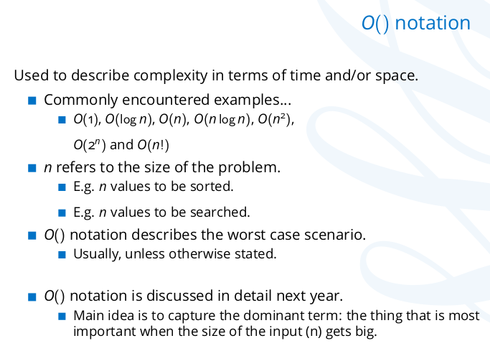
Big O notation:

Slide 27
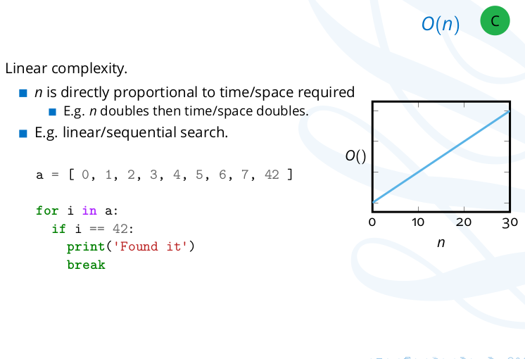
Linear Time Complexity:

Slide 28
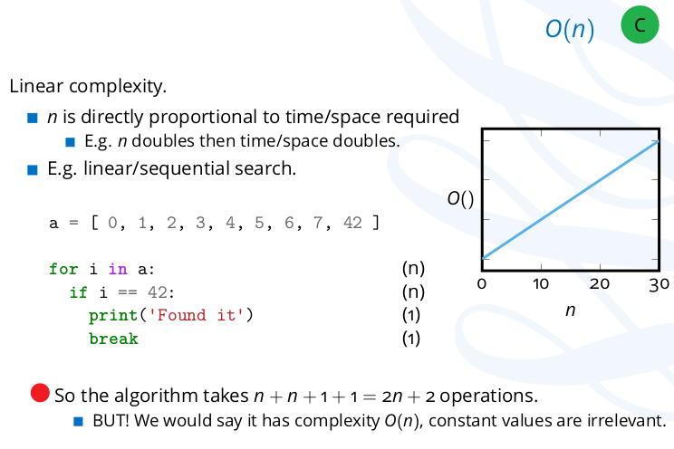
Linear Complexity

Slide 29
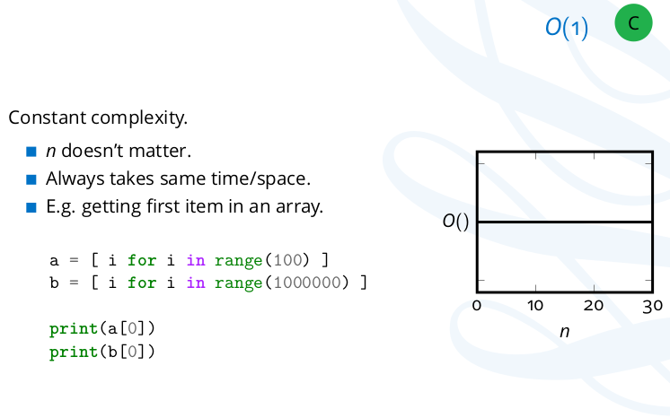
Constant Time Complexity

Slide 30
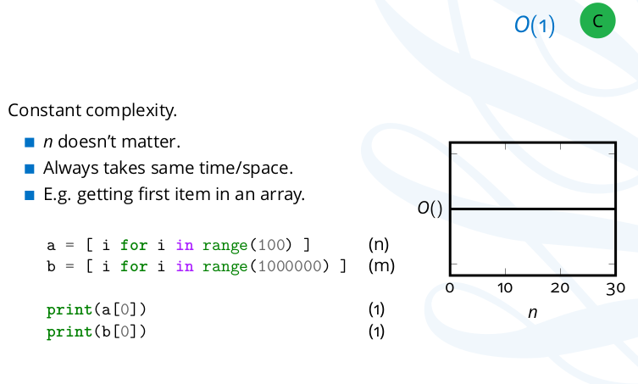
Constant Time Complexity:

Slide 31
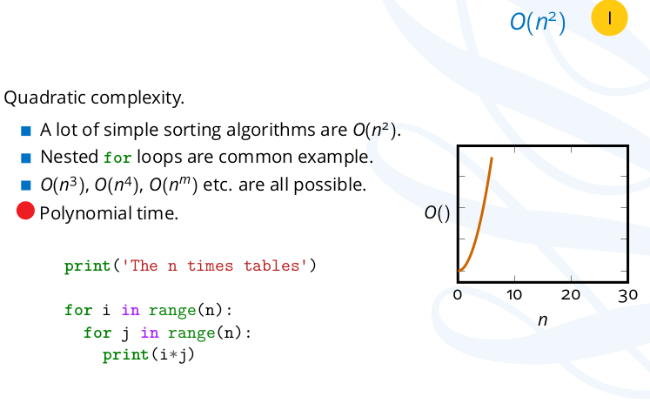
Quadratic Time Complexity:

Slide 32
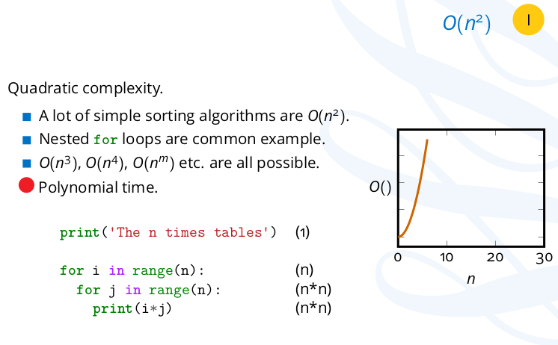
Quadratic Time Complexity:

Slide 33
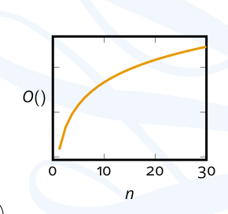
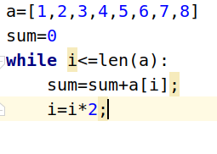
Logarithm Time Complexity:
log(n)
Each time it will divide the input in half.
Example of logarithm tome complextity is binary search

Slide 34
Logarithms
The inverse of exponentiation
2^3=8 log₂8=3
10^4=10000 log₁₀10000=4
Generally,
X^{z}=Y --> log_{x}Y=Z
In computer science we generally works with log base 2.
Link:https://www.youtube.com/watch?v=Hatl0qrT0bI

Slide 35
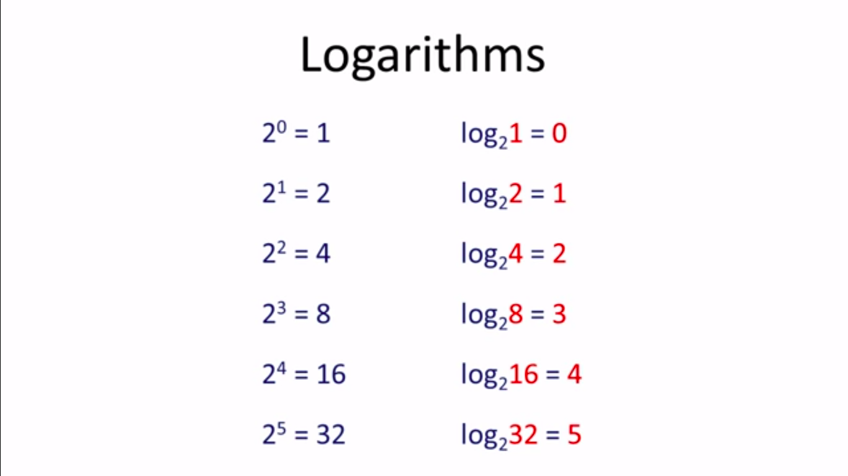

Slide 36
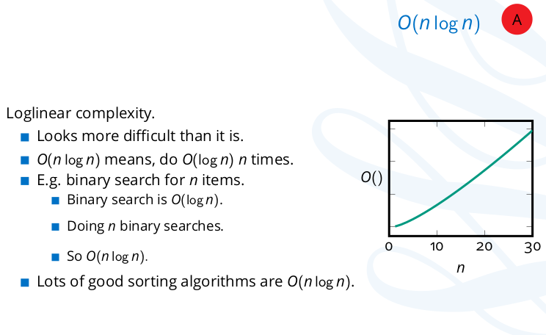
LogLinear Time Complexity:

Slide 37
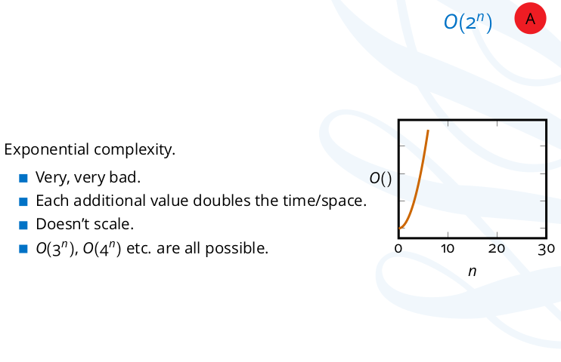
Exponential Time Complexity:

Slide 38
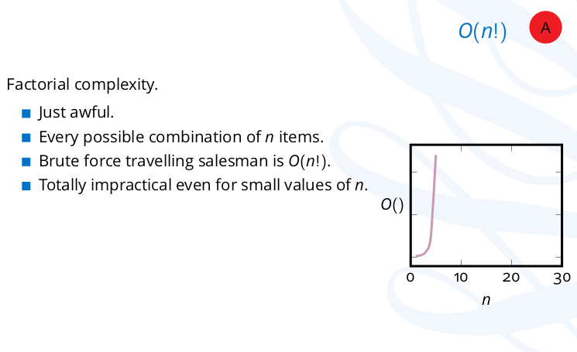
Factorial Time Complexity:

Slide 39
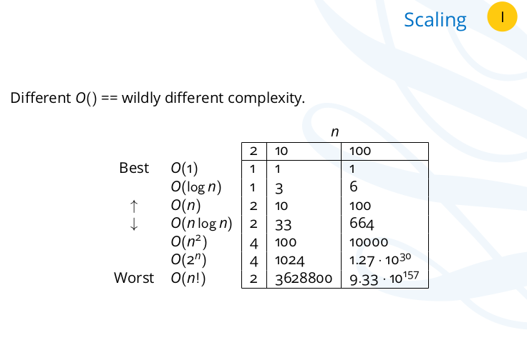
Big O notation scaling:

Slide 40
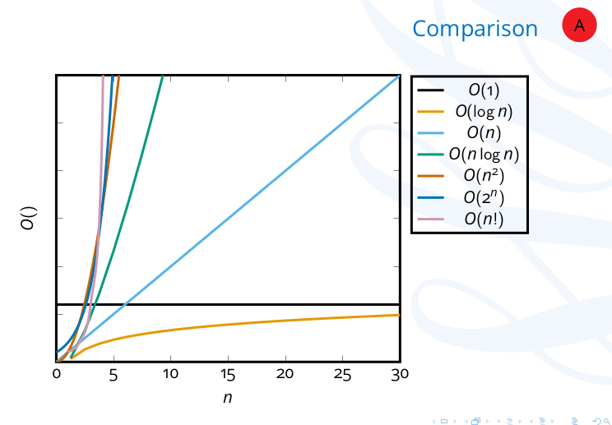

Slide 41
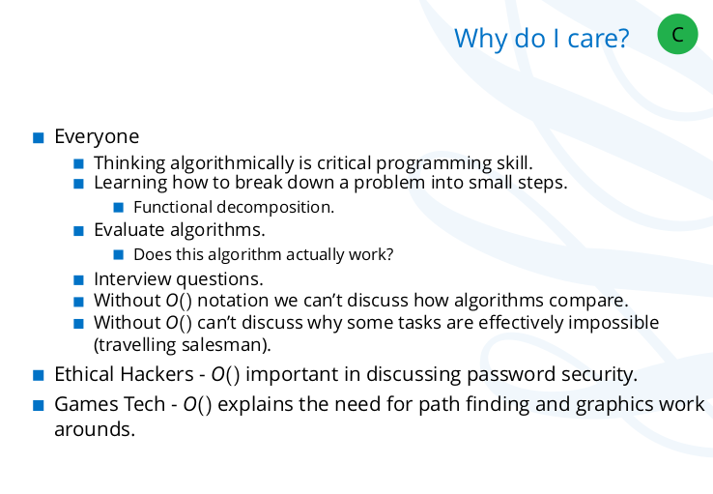

Slide 42
